Slide 1


Building a GCM with AI Agents
Lessons from developing PlaSiC, a coupled general circulation model in C
Sencan Sun 孙森灿
Department of Earth System Science, Tsinghua University

Slide 2
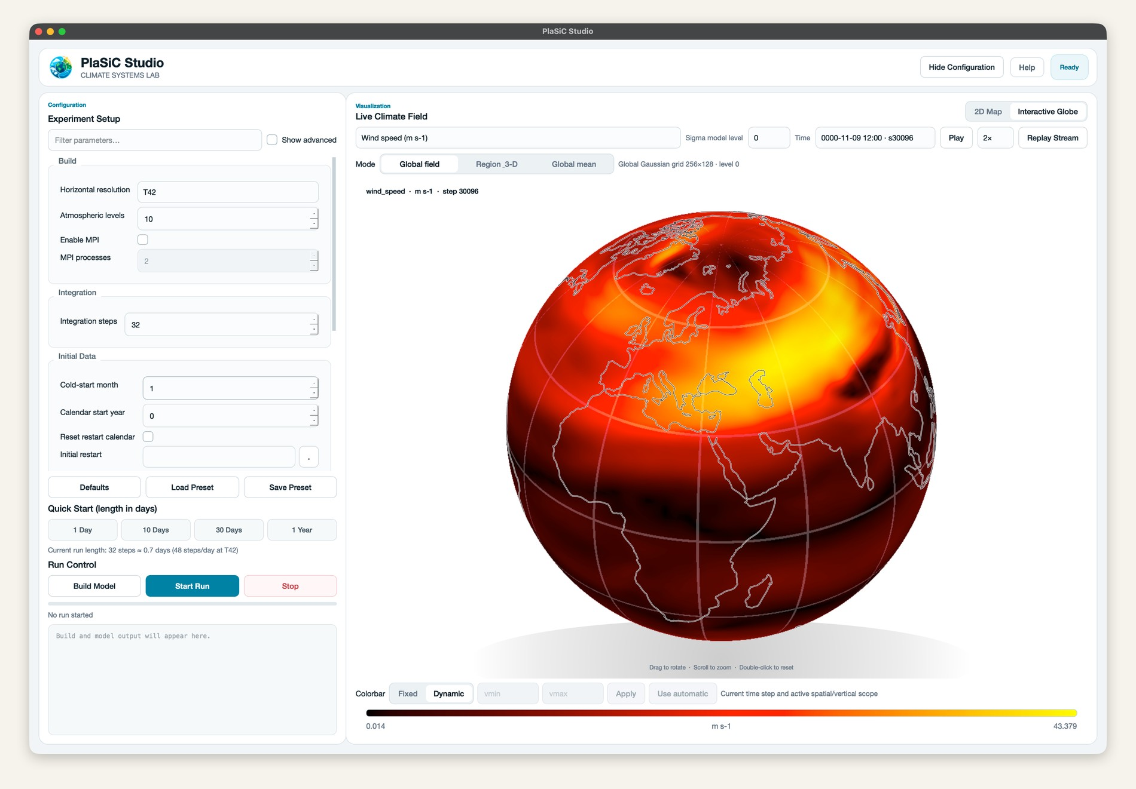
PlaSiC: a coupled GCM made to be understood
Planet Simulator in C: a full GCM with a textbook, reproducible experiments and a desktop app.
~20k
4
lines of C11, no Fortran
coupled components:
atmosphere, land,
sea ice, ocean
400+
1
pages of tutorial, online and as a PDF
PhD student, part-time, Feb–Sep 2026
2

Slide 3
A watershed year:
Nobody will write code by hand anymore.
WHY THIS TALK
2026

Slide 4
GCMs are extremely complex.
Respect that complexity in your head.
Keep a human in the loop.
PRINCIPLE 1
You cannot build one by throwing a few prompts at an agent.

Slide 5

An agent amplifies what you already know
MINDSET · PRINCIPLE 2
A coding agent is an assistant, not Aladdin’s lamp.
60%
0%
You could finish about 60% alone, given time: the agent gives you wings.
You would not know where to begin: the agent won’t get you far either.
So first learn how a GCM works.
Warner · Stocker · SpeedyWeather.jl ·
PlaSim reference manual
5

Slide 6
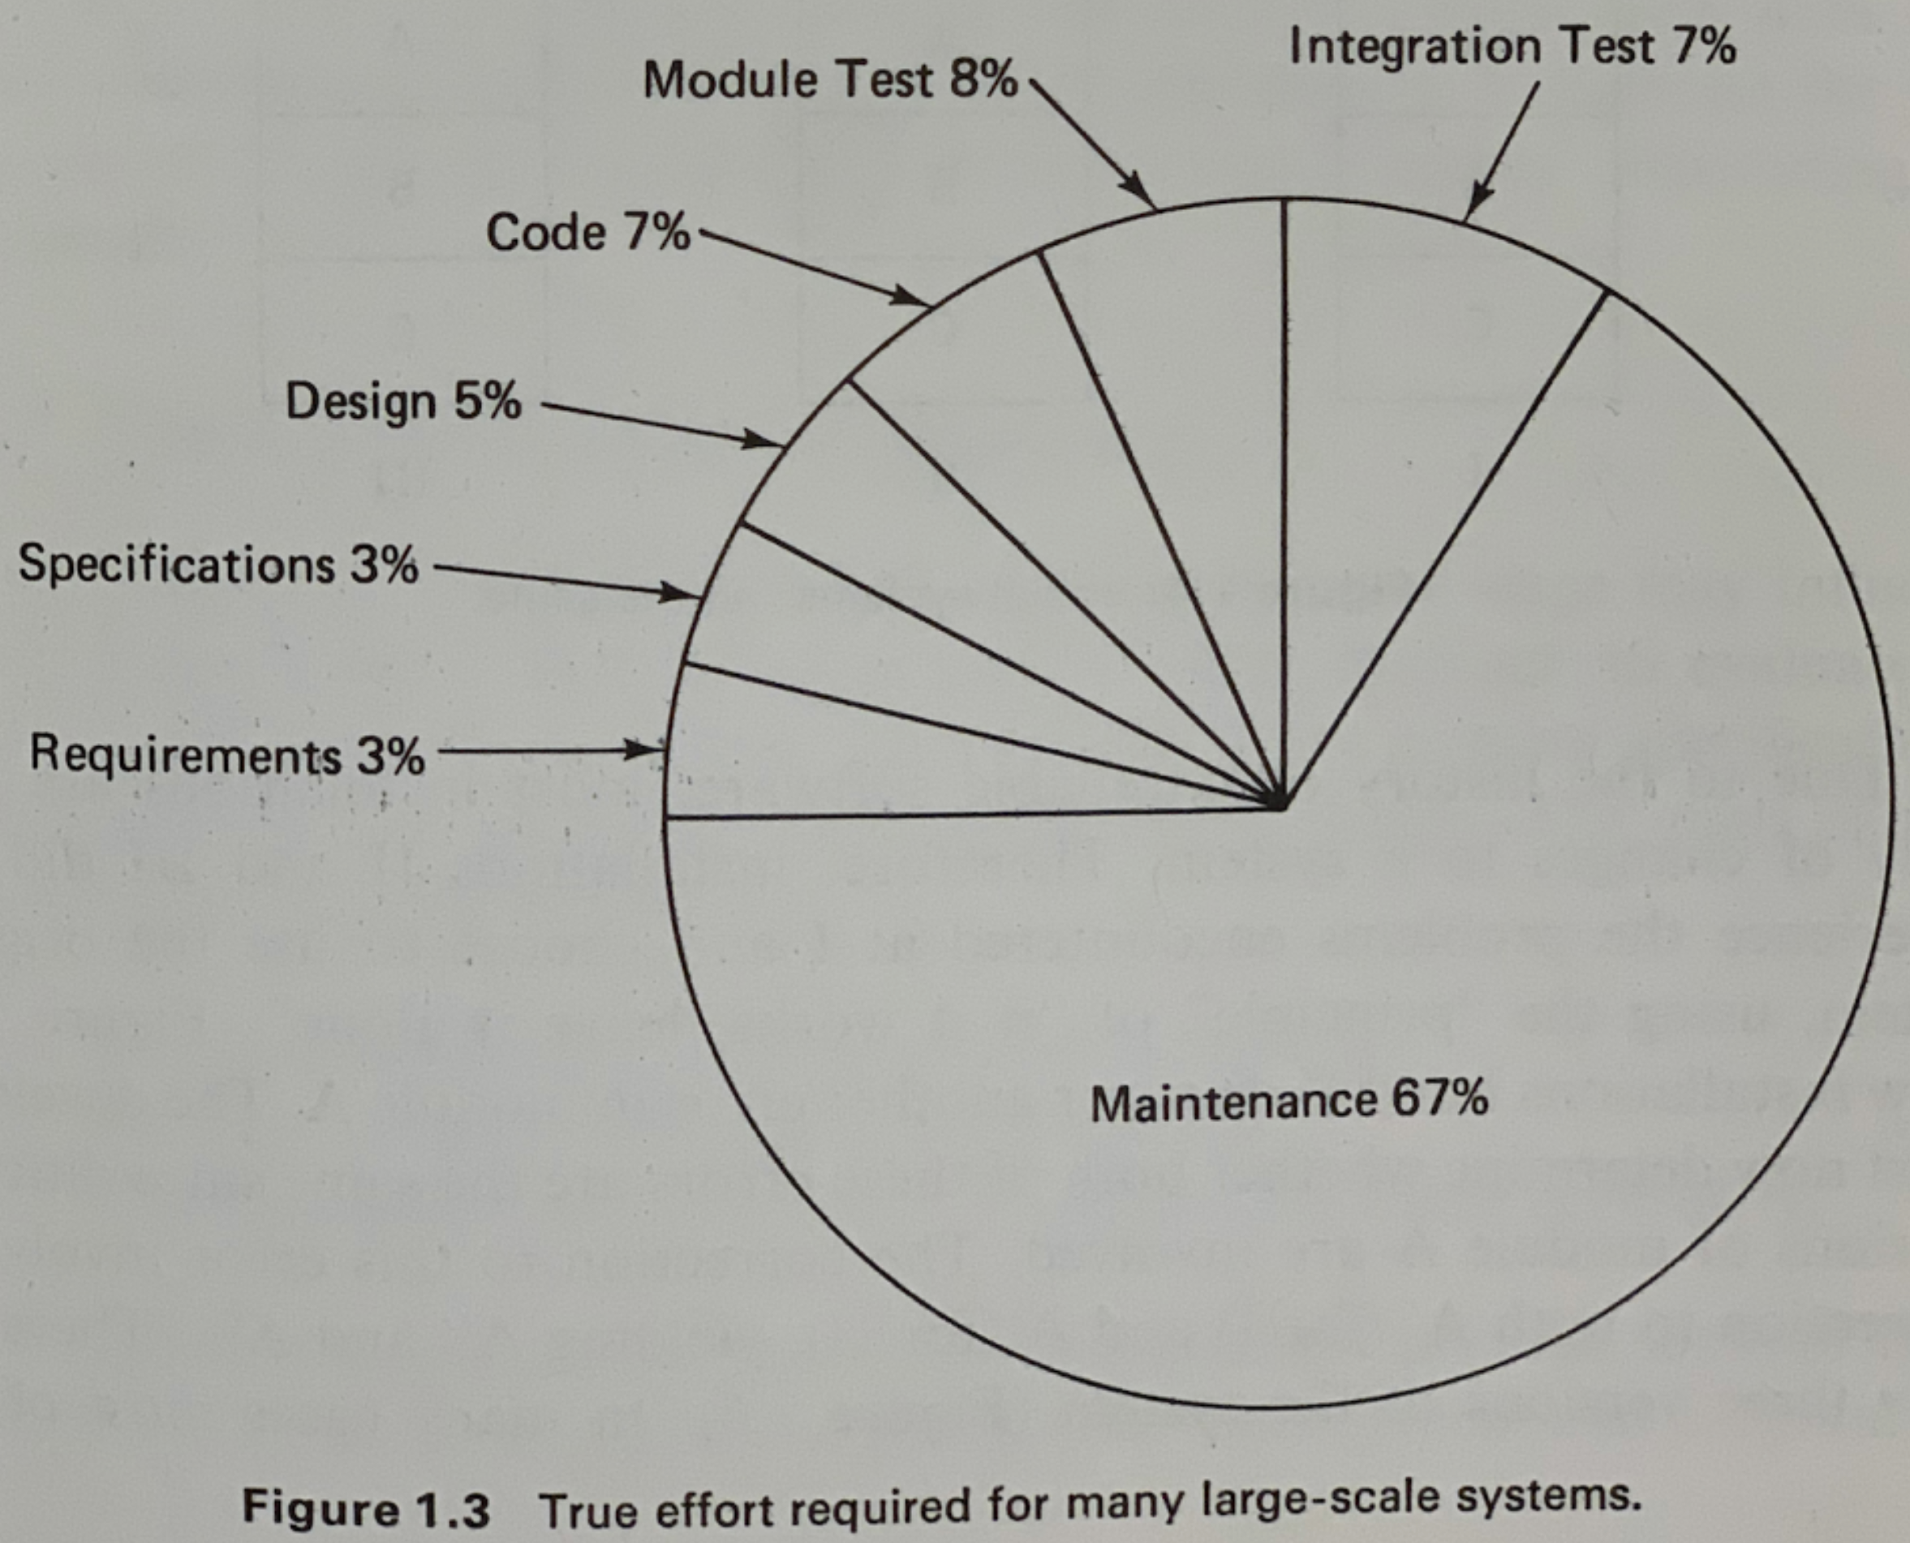
MINDSET · PRINCIPLE 3
Writing code is a small part of the job
6

Slide 7
Know your tool: Agent = LLM + Context + Tools
DEVELOP · PRINCIPLE 4
LLM
the model that reasons and
writes the code
EXAMPLE · KUO CONVECTION
kuo_convection.md
Context
everything it can read right now: your notes, the papers, reference code
your own notes from reading
the classic papers
reference_code/
Tools
what it can use: compiler, shell, all apps in your computer also
working implementations to inspect: SpeedyWeather.jl, PlaSim, Isca
tests/
Formula from Bojie Li, Understanding AI Agents
github.com/bojieli/ai-agent-book
what “done” means for this scheme
7

Slide 8
Define “done” first, then let agents iterate
DEVELOP · PRINCIPLE 5
1
Understand how the problem can be solved, not the exact code.
PLASIC’S DEFINITION OF DONE
$ make strict
2
Design the test cases and
acceptance criteria.
the whole build with every compiler
warning as an error
3
Let an agent, or a swarm of agents, iterate until every check passes.
$ make test-data
the simulation archive: names, dimensions, time axes, finite values
$ make test-runtime
“In early development,
only results matter.”
build and run end to end at T21, T31 and T42
8

Slide 9
Match the model to the task
DEVELOP · PRINCIPLE 6
GPT-6.1 Sol
GPT-6 Astra
Opus 5.5
GPT-6.1 luna
Deepseek v4.1 flash 1017
Tokens are not free: don’t use a sledgehammer to crack every nut.
Knowing when a stronger model is worth the cost takes a lot of hands-on use.
9

Slide 10
Review selectively, and in layers
MAINTAIN · PRINCIPLE 7
STEP 1
STEP 2
STEP 3
Ask for a walkthrough
Check the design
Read the core logic
pseudocode.md
Conceptual and architectural flaws show up here, before you read any code
Skim utilities and boilerplate; skip what is trivial
Algorithm, data flow and
key transformations,
in plain language
Reading every line wastes your time.
Reading none turns the code into
a big ball of mud.
Cross-check
LLM A writes the code; LLM B reviews it independently.
10

Slide 11
Review the whole repository every month
MAINTAIN · PRINCIPLE 8
Done regularly, this can decide whether a project is finished or abandoned halfway.
MAP
PRUNE
Rebuild the whole map in your head
Cut what agents over-produce
architecture and major modules
dependencies
duplicated code
excess defensive code
whole files nobody needs
Every extra line adds to the maintenance burden.
A healthy codebase is pruned regularly.
11

Slide 12
Get your hands dirty.
PRINCIPLE 9
Features are added bit by bit.
Get going, and don’t fear failure.
Thank you · Questions welcome

